Slide 1

Web Technology Project
Gym Management System

Slide 2
Project MEMBERS
Group Members:
Junaid Ahmed (21-A-583),
Ibrar Khan(21-A-624),
Abid (21-A-606)

Slide 3
Tools And technologies.
Front-end
Html, CSS, JavaScript
Back-end
PHP, MySQL
Software/IDE
Vs code, Wamp

Slide 4

Front-end
This is the main Page of our website
We can go to sign up page to assign
a new user.

Slide 5
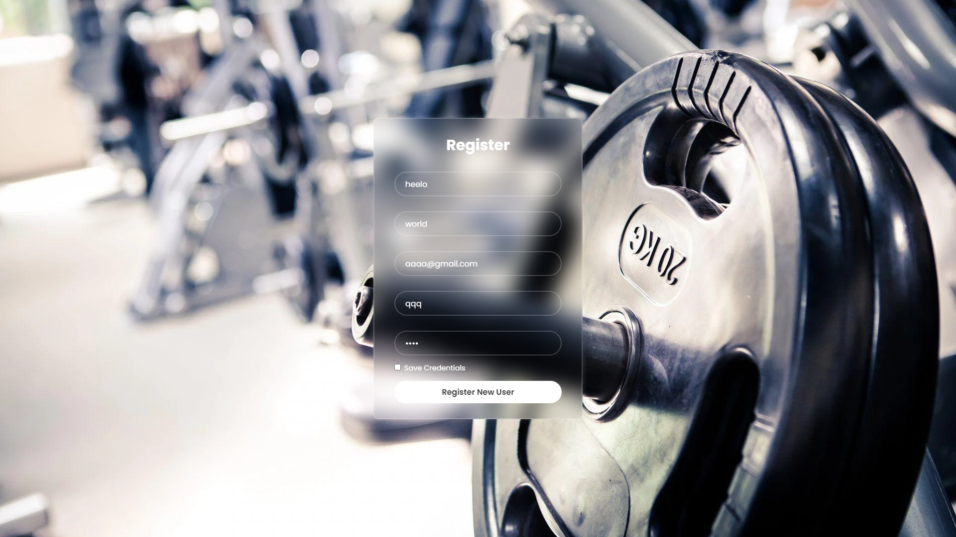
Front-end
We will now assign a new entry in the database :

Slide 6
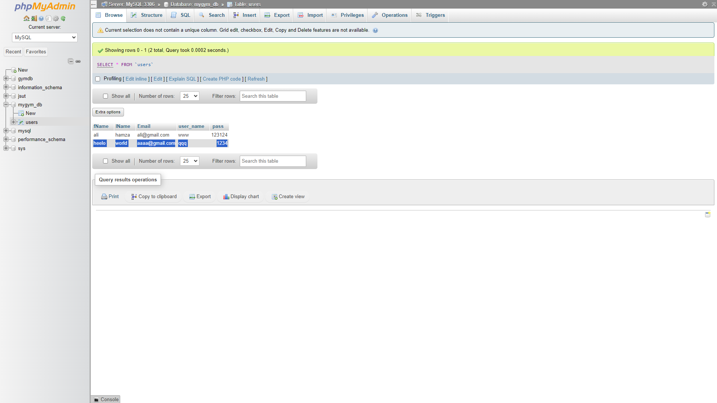
Back-end
We can check in the database whether the new entry is submitted or not, in this case its added in the database .

Slide 7
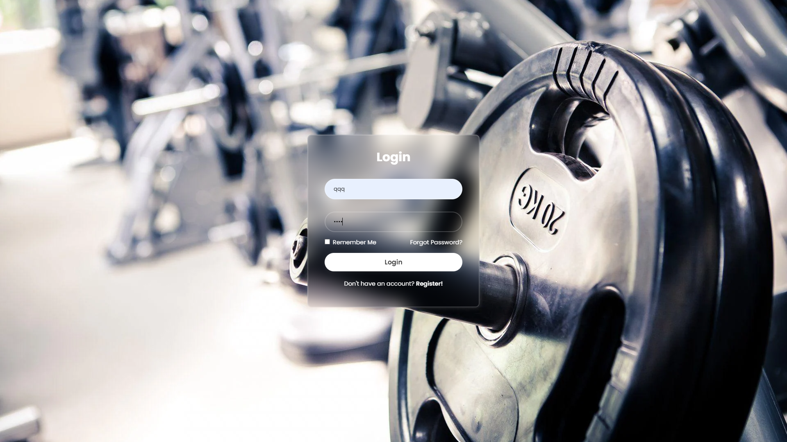
c
Now we can login to site by using the credentials stored In the database .You can check that this entry is saved in database
Which we saved in the previous slide.

Slide 8

Back-end
We can see that login was successful .if we entered wrong credentials it would give error.

Slide 9

Thank You
Submitted to :
Sir Amman
By :
Junaid Ahmed (21-A-583),
Ibrar Khan(21-A-624),
Abid (21-A-606)

